Slide 1

Major Project On Skin Cancer Detection Using Deep Learning
Presented By :
Aditya Agarwal(156301023)
Aditya Kumar Pal(156301024)
Amit Singh(156301033)

Slide 2
Basic Definitions
Artificial Intelligence :- The term "artificial intelligence" is applied when a machine mimics "cognitive" functions that humans associate with other human minds, such as "learning" and "problem solving".
Machine Learning :- Machine learning is an application of artificial intelligence (AI) that provides systems the ability to automatically learn and improve from experience without being explicitly programmed.

Slide 3
Abstract
In this project, we will design an algorithm that can visually diagnose melanoma,
the deadliest form of skin cancer. In particular, our algorithm will distinguish this
malignant skin tumor from two types of benign lesions (nevi and seborrheic
keratoses).
In this project, we have completed two independent binary image classification tasks
that involve three unique diagnoses of skin lesions (melanoma, nevus, and
seborrheic keratosis). In the first binary classification task, participants are asked to
distinguish between (a) melanoma and (b) nevus and seborrheic keratosis. In the
second binary classification task, participants are asked to distinguish between (a)
seborrheic keratosis and (b) nevus and melanoma

Slide 4
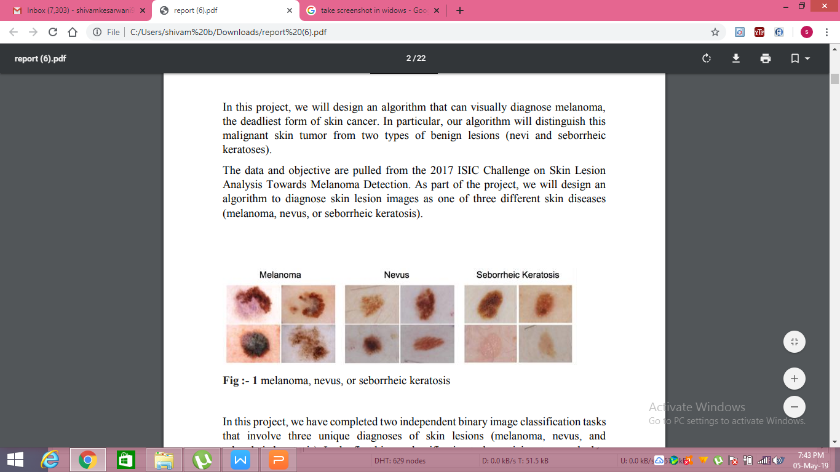
Melanoma – malignant skin tumor, derived from melanocytes (melanocytic)
Nevus – benign skin tumor, derived from melanocytes (melanocytic)
Seborrheic keratosis – benign skin tumor, derived from keratinocytes (nonmelanocytic)

Slide 5
CNN – Algorithm we have used to train our model
CNN image classifications takes an input image, process it and classify it under certain categories
In CNN models to train and test, each input image will pass it through a series of convolution layers with filters (Kernals), Pooling, fully connected layers (FC) and apply Softmax function to classify an object with probabilistic values between 0 and 1.
Computers sees an input image as array of pixels
It deals with the highlighted and major features of the image.

Slide 6
Dataset Used
Our dataset comes from a combination of open-access dermatology repositories, the ISIC Dermoscopic Archive, the Edinburgh Dermofit Library and data from the Stanford Hospital. .
The images from the online open-access dermatology repositories are annotated by dermatologists, not necessarily through biopsy.
The ISIC Archive data used are composed strictly of melanocytic lesions that are biopsy-proven and annotated as malignant or benign.
The Edinburgh Dermofit Library and data from the Stanford Hospital are biopsy-proven and annotated by individual disease names 12 (that is, actinic keratosis).
In our test sets, melanocytic lesions include malignant melanomas—the deadliest skin cancer—and benign nevi.

Slide 7
In our test sets, melanocytic lesions include malignant melanomas—the deadliest skin cancer—and benign nevi.
Epidermal lesions include malignant basal and squamous cell carcinomas, intraepithelial carcinomas, premalignant actinic keratosis and benign seborrheic keratosis
2000 images are provided as training data, including 374 "melanoma", 254 "seborrheic keratosis", and the remainder as benign nevi (1372). The training data is provided as a ZIP file, containing dermoscopic lesion images in JPEG format and a CSV file with some clinical metadata for each image.
All images are named using the scheme ISIC_<image_id>.jpg, where <image_id> is a 7-digit unique identifier. EXIF tags in the images have been removed; any remaining EXIF tags should not be relied upon to provide accurate metadata

Slide 8
Tools Used
Sl. No. | Tool | Description
1. | Google Cloud Platform | Used to train model
2. | Jupyter Notebook | Python IDE
3. | Heroku | Platform on which flask script has been loaded
4. | Android Studio | Ide for android application

Slide 9
Libraries Used
Sl. No. | Library
1. | Keras
2. | Sklearn
3. | Skimage
4. | Theano
5. | Pillow
6. | Flask
7. | Gunicorn
8. | Postman
9. | Volley (REST API )

Slide 10
Convolution Neural Network Modelling
During model training we have used modified google resnet model. We have popped the last layer of resnet model and append relu layer followed by fully connected layer1 having 2048 input neurons and 1024 output neurons, followed by batch normalization layer then final fully connected layer having 1024 input neurons and 3 out put neurons.
The google resnet model has 4 layers each with multiple bottleneck layers each consists of some combination of convolution layer, pooling layer, batch normalization layer.

Slide 11
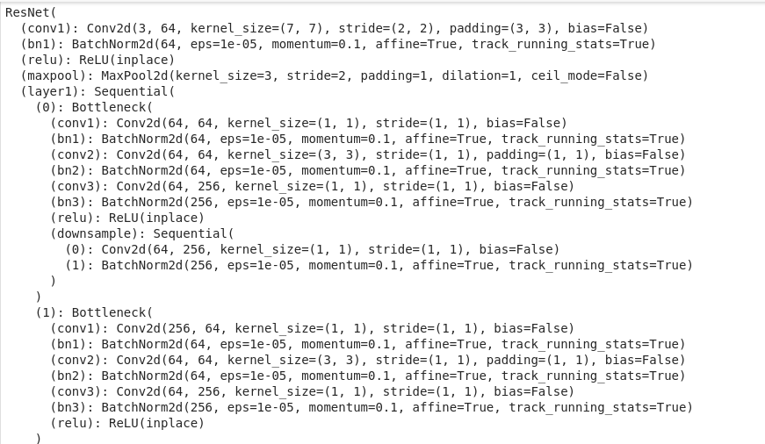

Slide 12
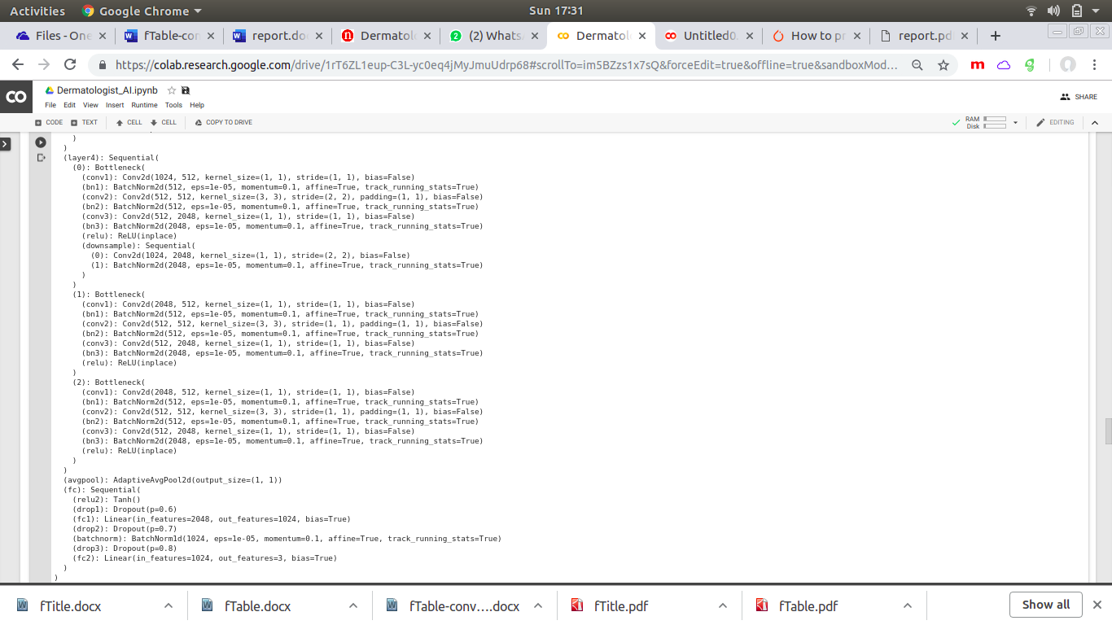

Slide 13
Backend Script using Flask on Heroku
The application uses a back-end server deployed on Heroku, that provides cloud platform as a service (PaaS). The server runs a python script that accepts incoming HTTP requests, in our case, POST requests, using the Flask web micro-framework.
The server has the following files stored:
The exported trained Keras model, named predictor_sa.h5
A python script that accepts incoming HTTP POST requests by implementing the Flask micro-framework and returns a predicitons as json, named predictor.py.
A Procfile that contains commnds to be run by the Heroku dyno, named Procfile
A text file that contains all the required libraries that need to be installed in order to run the script, named requirements.txt
A text file that mentions the runtime environment and its version for the script.

Slide 14
2.5.2 Flowchart:
-The android app sends HTTP POST requests
-The python script receives that request by implementing the Flask micro-framework
-The script calls the loadthemodel() function which loads the trained Keras model. This function is called only once and that is when the first POST request is received.
-Now the make_predict() function is called which json sent through the POST request.
-Now the image url is extraced from the json and then the image is downloaded.
-The downloaded image is resized into a 220*220 image.
-Now pixel data of this resized image is extracted and then saved in a 220*220 matrix.
-Now the reshaped matrix is provided as an argument to the predict () function of keras.models.Model class.
-The result returned by the predict () function is stored in a json and returned as the response to the incoming POST request.

Slide 15
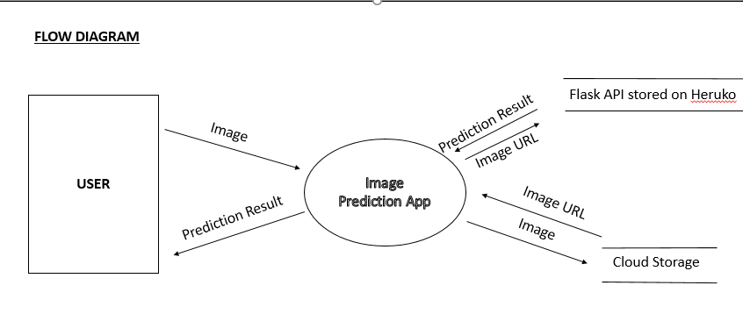
Skin Cancer Detection Android Application

Slide 16
User uploads a image into the app. The image can be upload through gallery or can be clicked instantly.
On clicking on upload image, the image gets stored in Firebase Storage. The Firebase storage returns the image URL to the app.
The URL of the image is sent to the Flask Script stored n Heroku Server using a post request through Volley.
The Script on the Heruko server loads the model. It downloads the image for given url and then resizes it and converts into grayscale using Pillow library. The gray scaled image is then predicted using the loaded model.
The prediction result is sent in the JSON format to the app.
The app shows the result to the user.

Slide 17

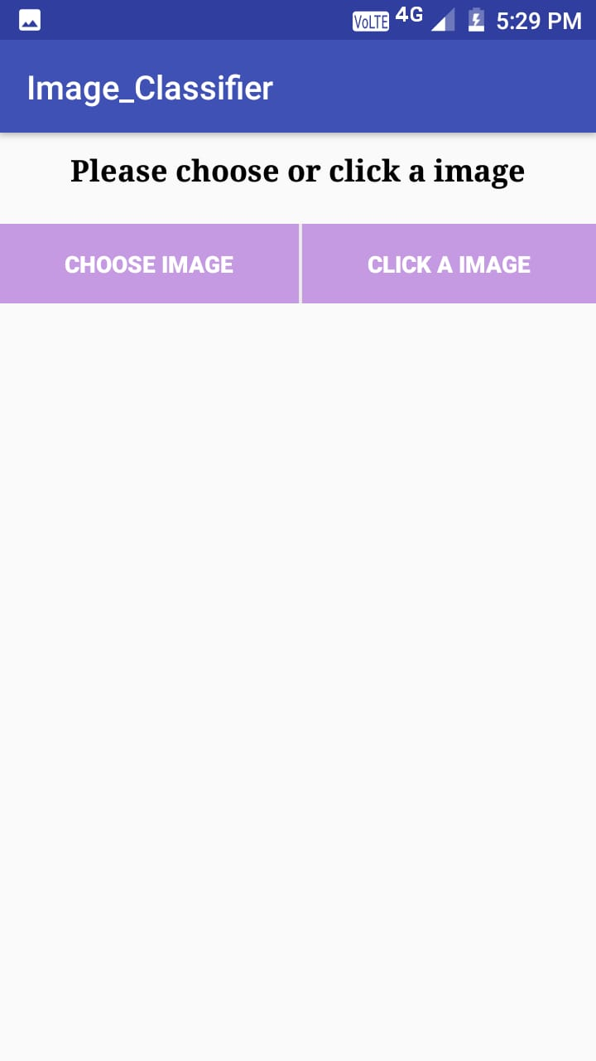
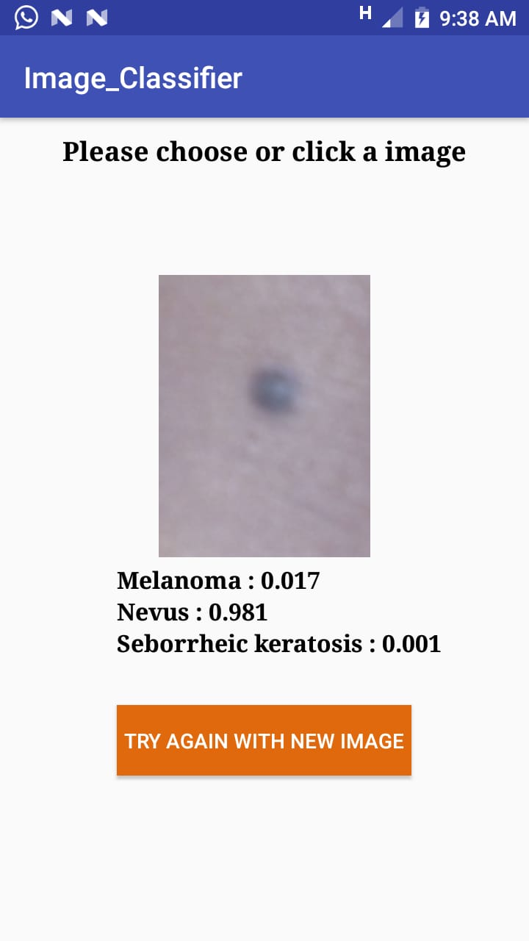
Gender Classification Android Application

Slide 18
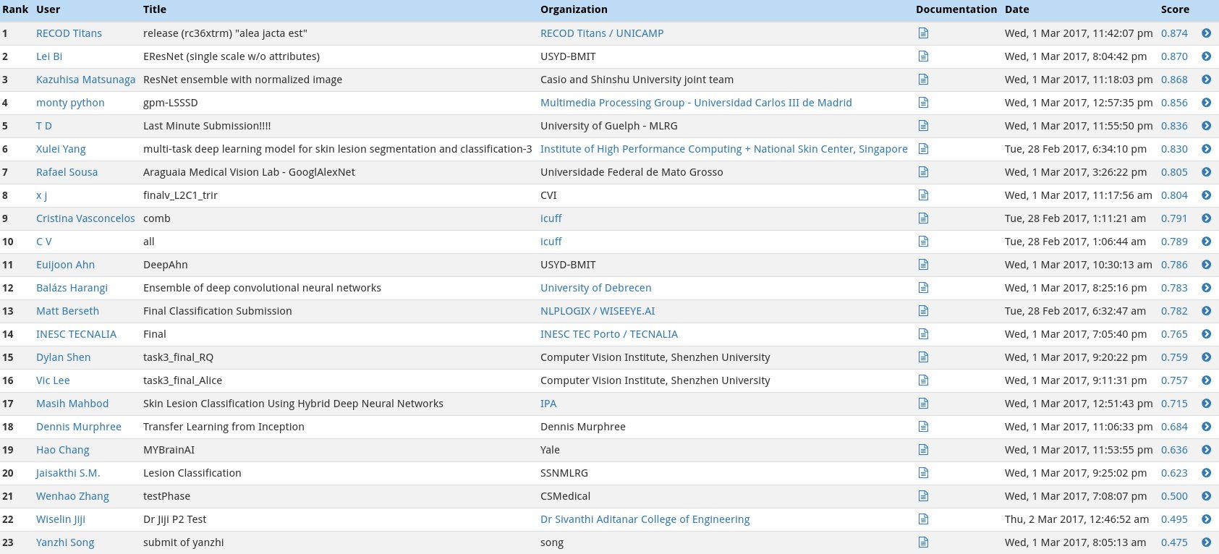
ISIC Leadership Board In category 1 our model' score is 0.865

Slide 19
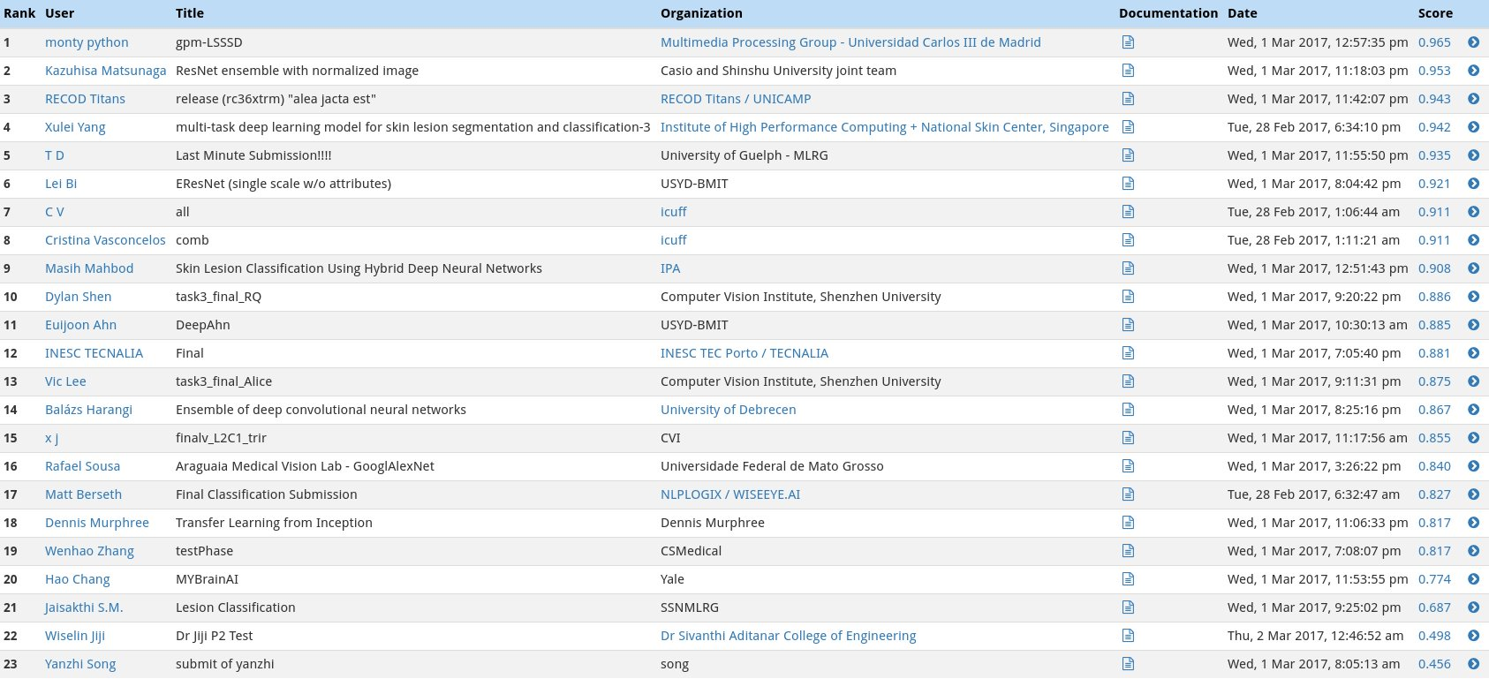
In category 2 our model' score is 0.914.

Slide 20
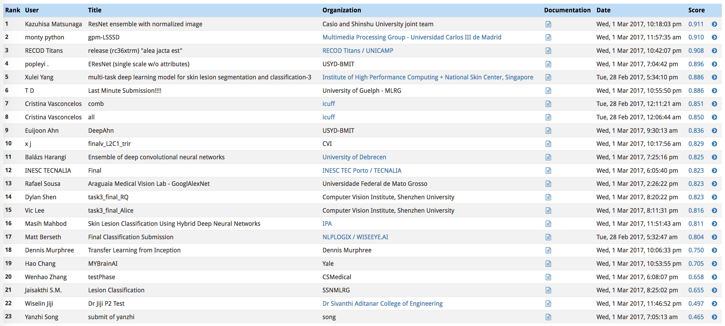
In category 3 our model' score is 0.890.

Slide 21
Conclusion & Future Aspects
The entire model was trained on high resolution medical images. But in reallife scenerio the imges will be taken from mobile phones. So we need to create dataset of images clicked from mobile phones.
The accuracy of our model is near to 76% and according to a survey a average dermatoligist have a accuracy rate of 70%.
The total ratio of patients per dermatologist is quite high and may tend to increase with the increasing rate of pollution. So this feature can prove to be quite helpful ,given that the actual accuracies of our model and actual dermatologists is almost same.
A web application can prove to be quite helpful fot the same.
By 2021 there would be 6.3 billion smartphone users. So this project provides low cost universal access diagnostic care for deadliest skin cancer.

Slide 22
Thank You

